Slide 1



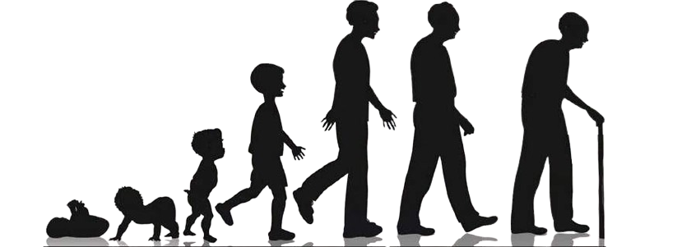
Life expectancy
and factors affecting it
Beneggi Alessandro, 26211A
Garcia Tejada Melvin Ramiro, 20934A
Finazzi Marta, 13254A

Slide 2
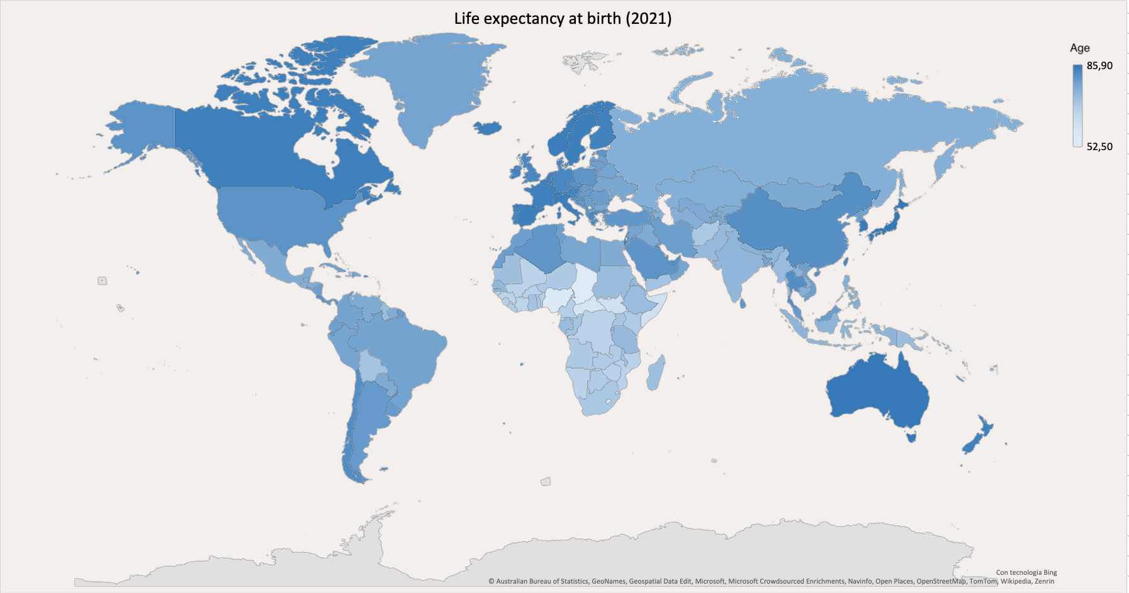
In the whole world...

Slide 3
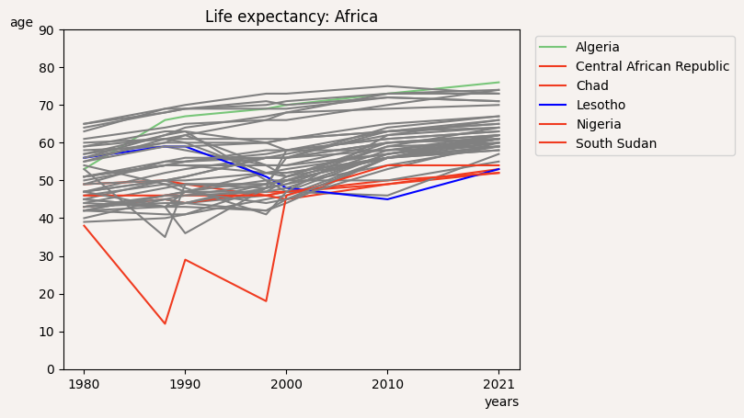
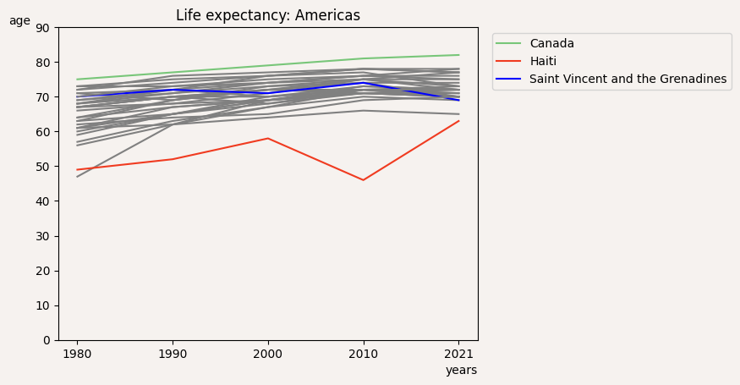
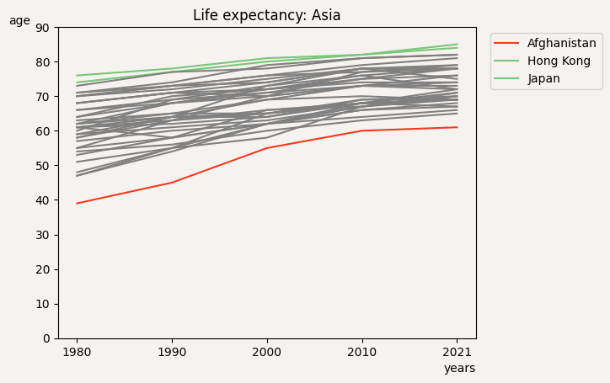
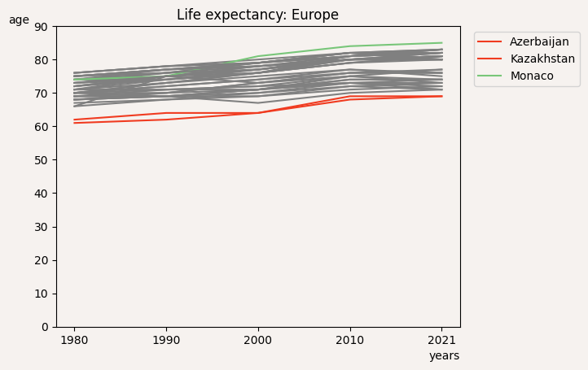
Life expectancy in different geographical areas

Slide 4
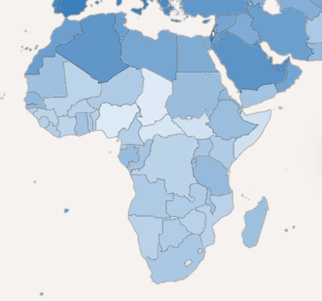



Let’s focus on the worst african countries
Central African Republic
Chad
Nigeria
South Sudan

Slide 5
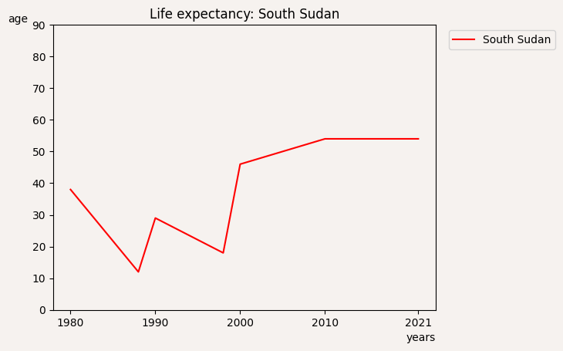
South Sudan
Sudan suffered 17 years of civil war (1955-1972), followed by a second civil conflict (1983-1998). In 1989, colonel Omar al-Bashir planned a coup d’Etat, proclaming himself president. The civil war finished with a peace agreement that granted autonomy to the southern region. In 2011, a referendum ratified South Sudan’s separation, occured with Sudan’s consent in July 9, 2011.

Slide 6
Factors affecting life expectancy
Natural Disaster
Undernourishment
Hunger index
Diseases: Hiv, Malaria, Tuberculosis

Slide 7
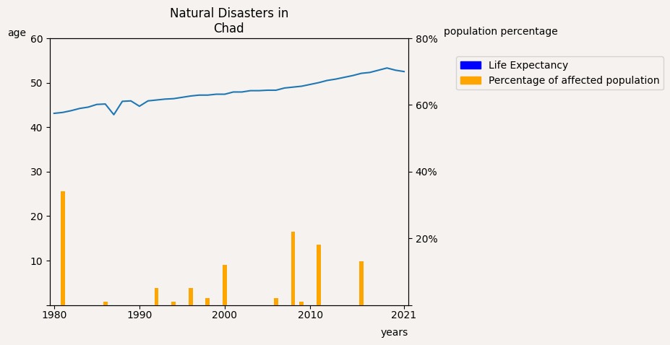
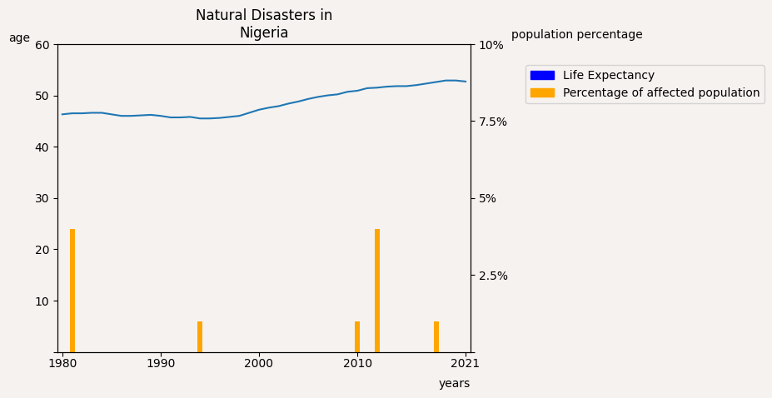
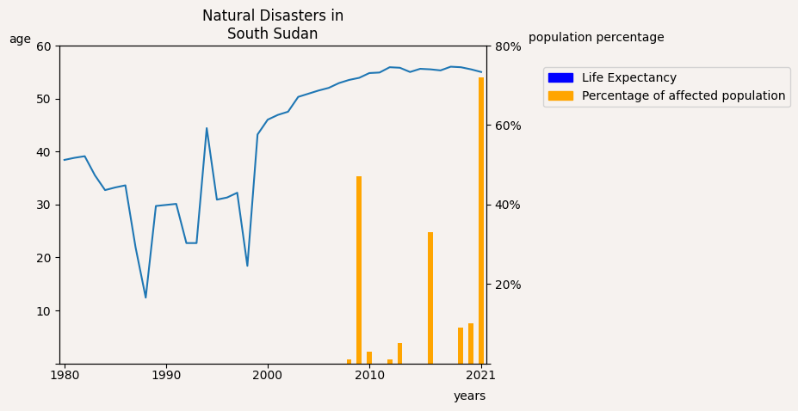
Natural disasters

Slide 8
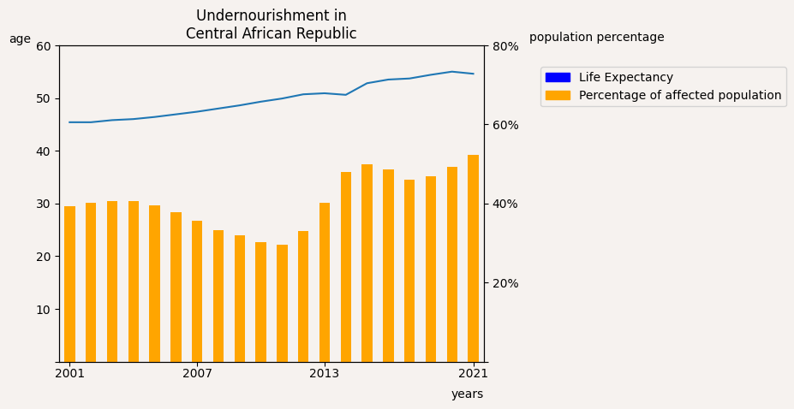
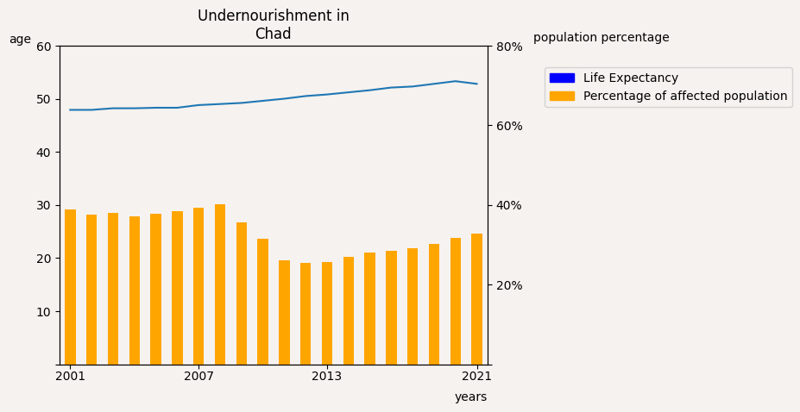
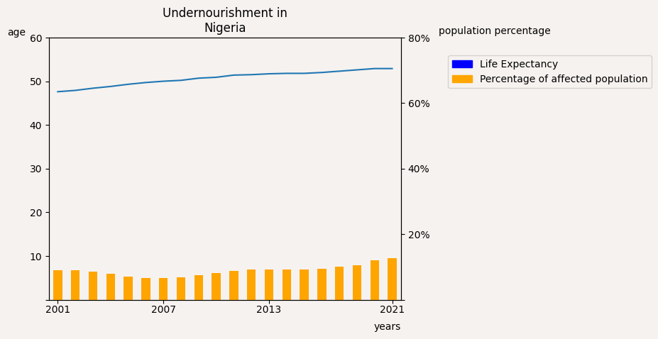
Undernourishment

Slide 9




GHI
The Global Hunger Index (GHI) is a tool designed to comprehensively measure and track hunger at global, regional, and national levels, reflecting multiple dimensions of hunger over time
Undernourishment:
Child mortality:
the share of the population whose caloric intake is insufficient
the share of children who die before their fifth birthday
Child stunting:
Child wasting:
the share of children under the age of five who have low height for their age
the share of children under the age of five who have low weight for their height

Slide 10
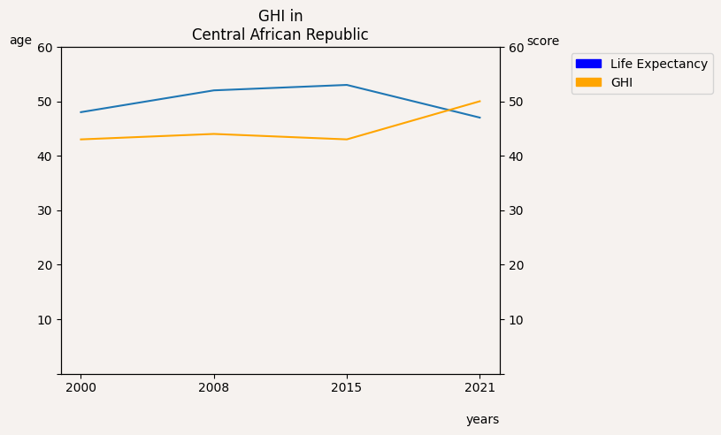
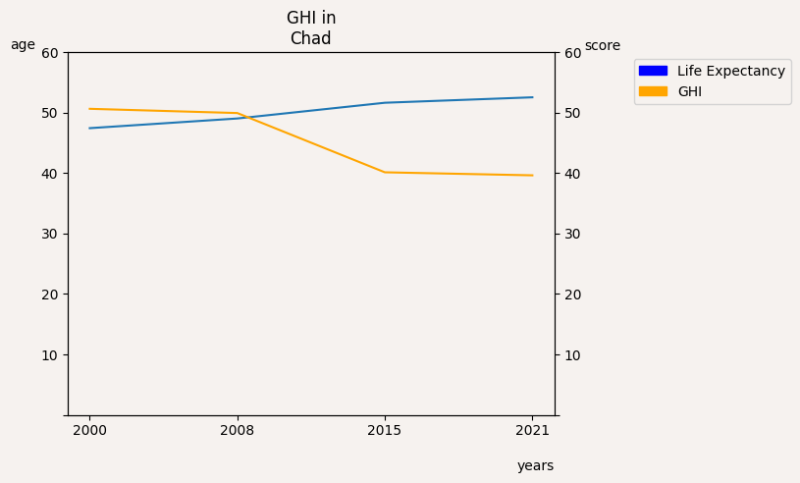
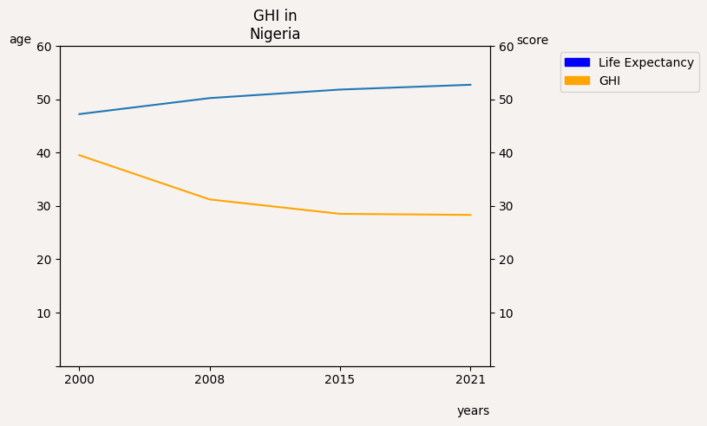
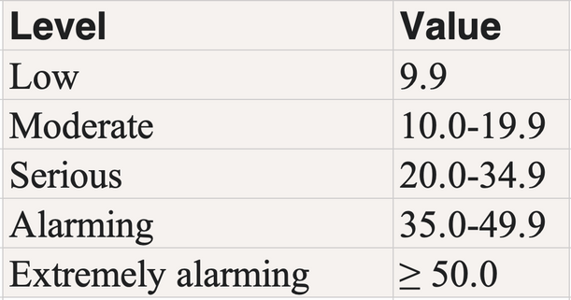
Hunger index

Slide 11
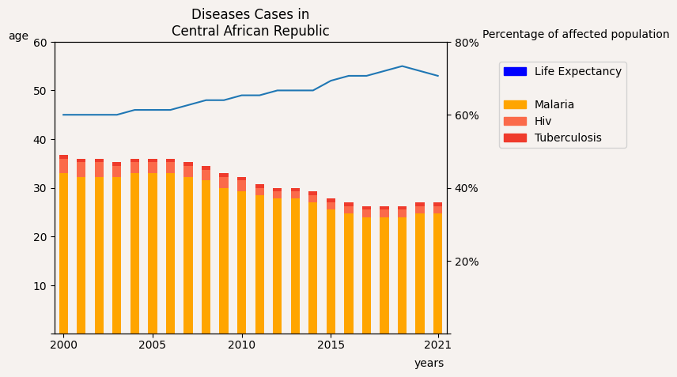
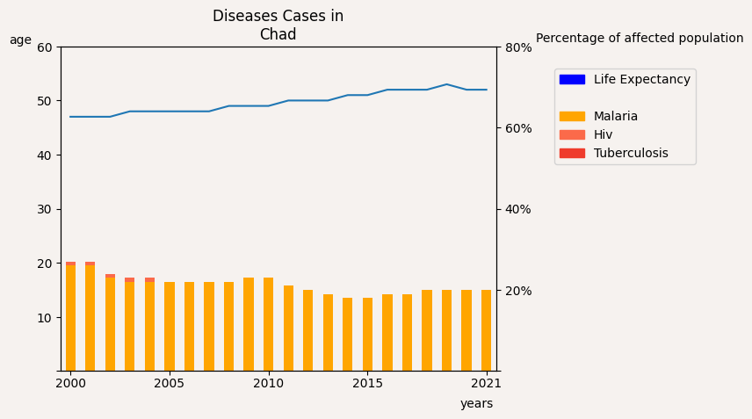
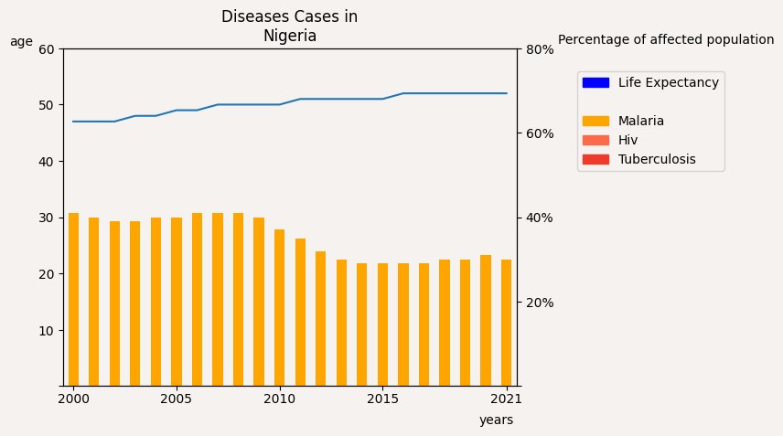
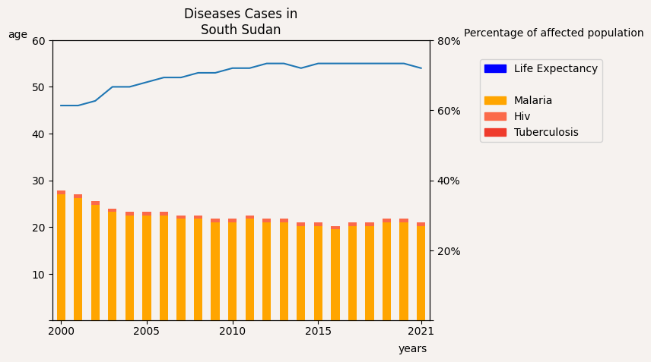
Diseases cases

Slide 12
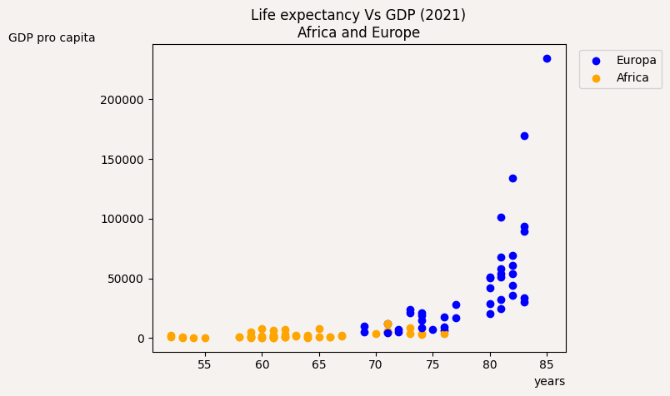
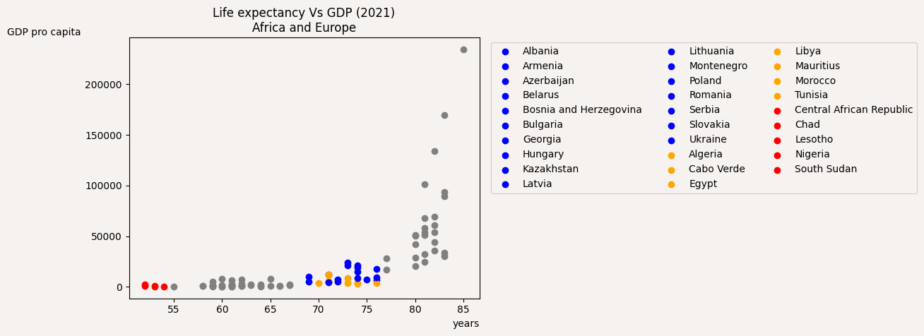
Africa Vs Europa

Slide 13
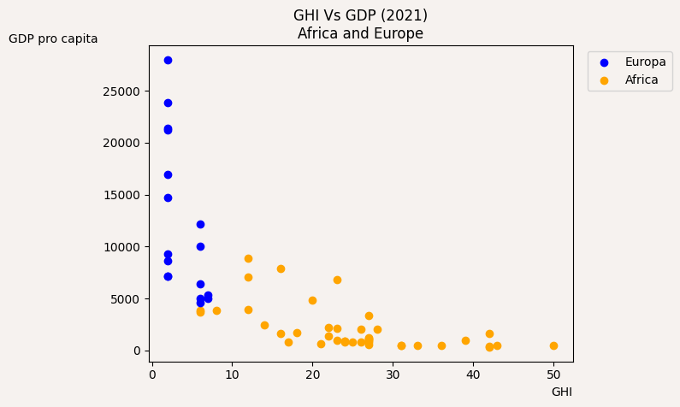

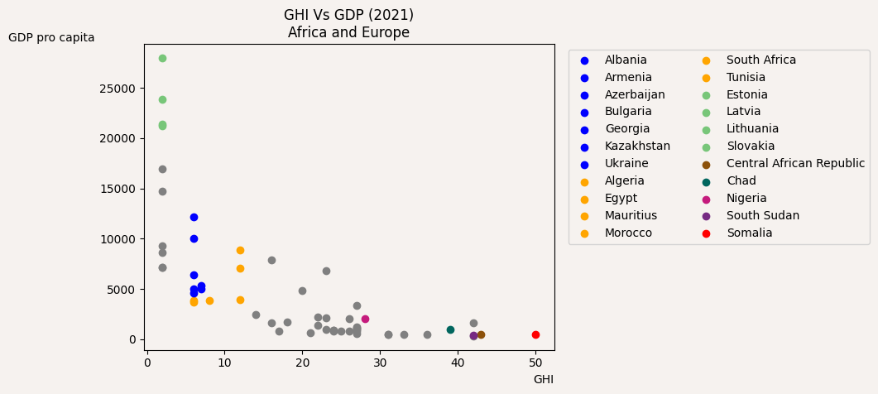
GHI vs GDP
The total monetary or market value of all the finished goods and services produced within a country’s borders in a specific time period

Slide 14
Diseases
https://apps.who.int/gho/data/node.main-afro
GHI
https://it.wikipedia.org/wiki/Indice_globale_della_fame
People affected by natural disasters
References
https://climateknowledgeportal.worldbank.org/country/central-african-republic/vulnerability
Life expectancy
https://www.indexmundi.com/map/?t=0&v=30&r=xx&l=it
Sudan
https://it.wikipedia.org/wiki/Sudan
Others
https://data.un.org/

